Slide 1
Basic R
“Processing large dataset with R”

Slide 2
Instructors
Silvia
BOTTINI
silvia.bottini@univ-cotedazur.fr
Theoretic classes
Giulia
MARCHELLO
giulia.marchello@inria.fr
Practical classes

Slide 3

Materials
https://classroom.google.com/c/MzIwODkzODg0NTM0?cjc=lcuaf7n

Slide 4

Why R?
Interactivity
Scripting
Open Source
Multi platform
Notes:
R is not a programming language like C or Java.
It was not created by software engineers for software development.
Instead, it was developed by statisticians and data analysts
as an interactive environment for data analysis.
The interactivity is an indispensable feature in data science
However, like in any other programming language,
you can save your work as scripts, which you can easily execute at any moment.
R is free and open source, meaning that you can look at the code.
There's also a large and growing active community of R users. It's easy for others to contribute add-ons,
which enable developers to share software implementations of new data
science techniques.
It runs across all major platforms--
Windows, Mac OS, Unix, Linux.

Slide 5

Drawbacks
Not user friendly @ start
Data preparation
No easy debugging
Working with large datasets is limited by RAM

Slide 6
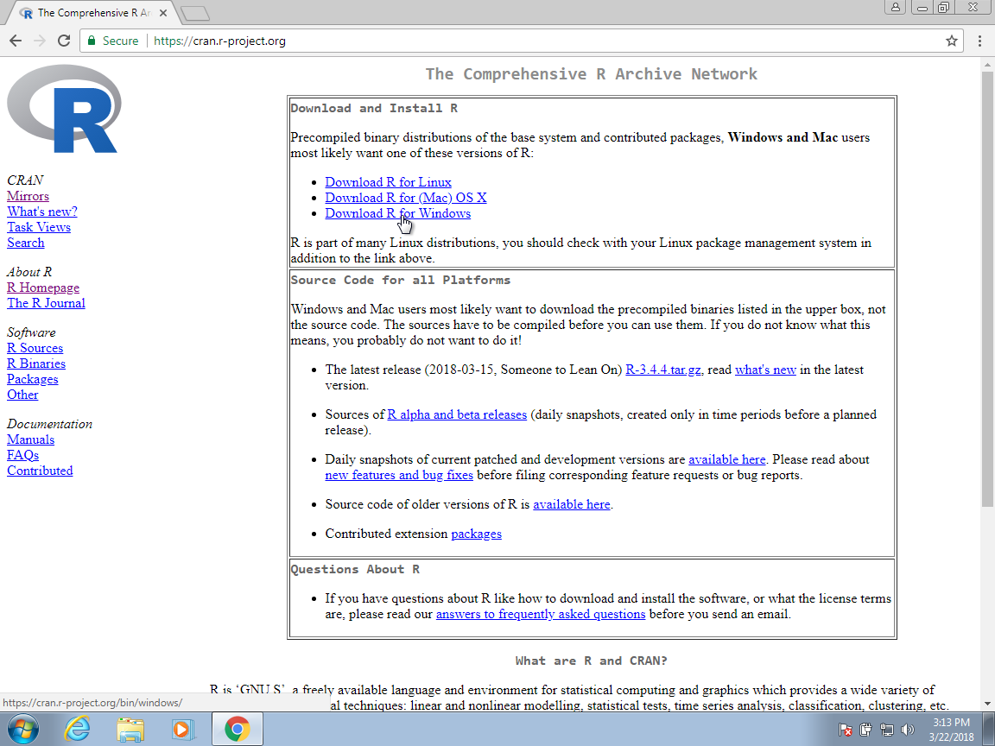


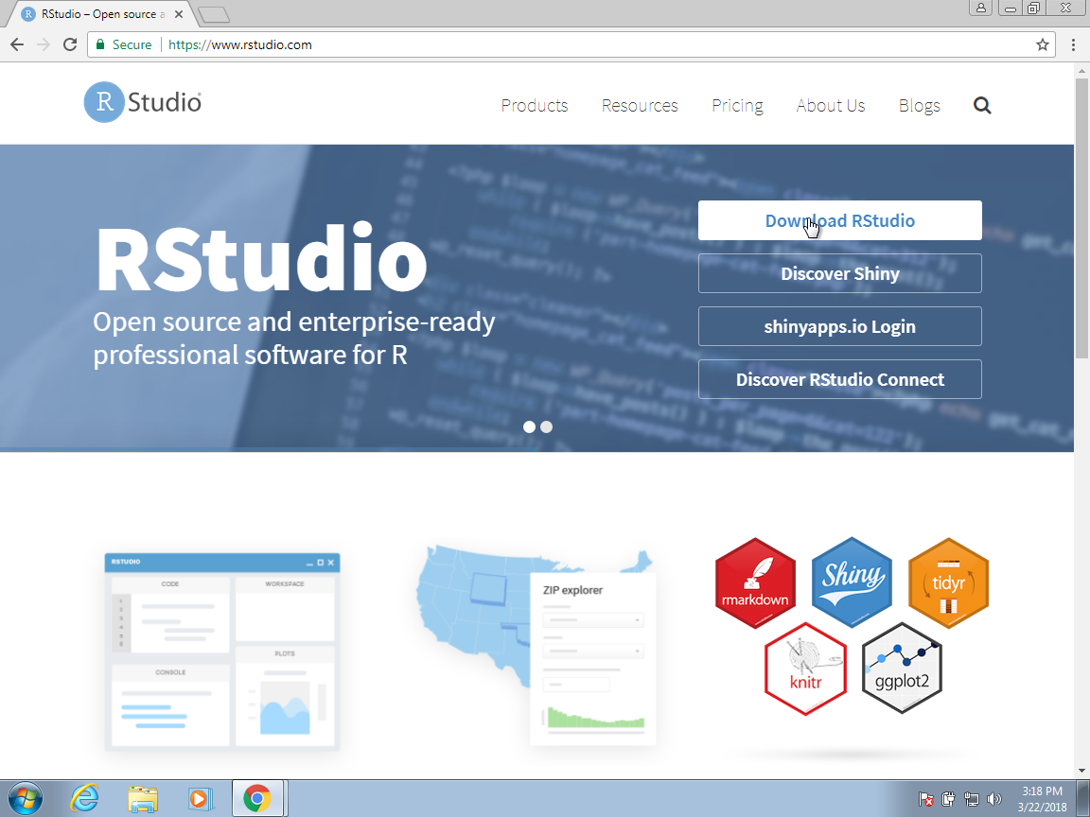
Let’s start
Download R: Console & RStudio

Slide 7
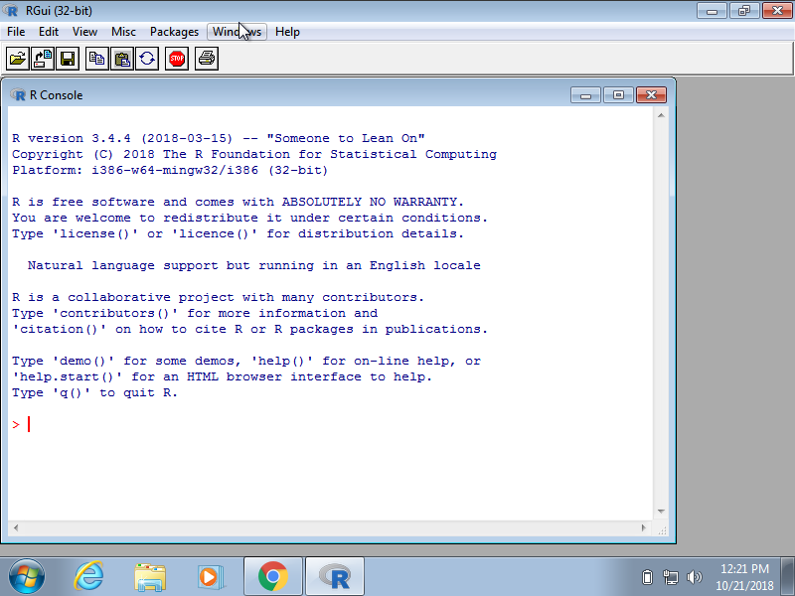
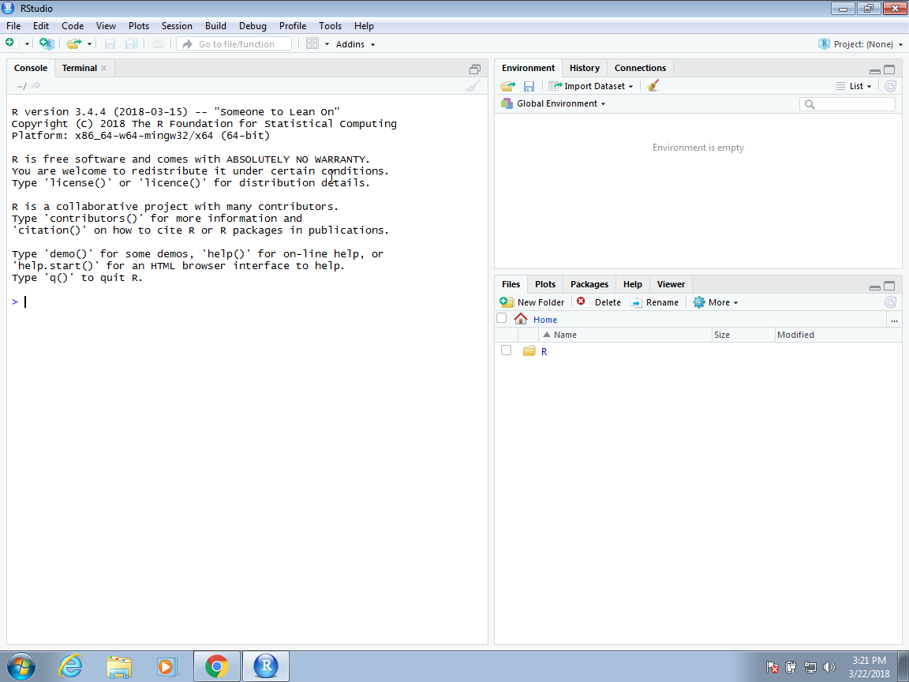
Let’s start
Download R: Console & Rstudio
Open the console

Slide 8
Let’s start
Download R: Console & Rstudio
Open the console
Make simple calculation
> 2 * 2
 [1] 4
> 0.15 * 19.71
 [1] 2.96
> exp(-2)
 [1] 0.1353353

Slide 9
Let’s start
Download R: Console & Rstudio
Open the console
Make simple calculation
Make more complex calculation
> ?t.test
Description: a short description in English of the method implemented in the function
Usage: the way the function should be used, with all input parameters and their default values
Arguments: a detailed explenation of the input parameters
Values: a detailed explenation of the output fields

Slide 10
Let’s start
Download R: Console & Rstudio
Open the console
Make simple calculation
Make more complex calculation
Install libraries
# installing the package
> install.packages("dslabs")
 The downloaded binary packages are in
/var/folders/0t/35l1qfw53xqbdy1ldsnljgmc0000gn/T//Rtmp9XgRWo/downloaded_packages
# loading the package > library(dslabs)
Notes:
The extra functionality comes from add-ons available from developers.
There are currently hundreds of these available from CRAN,
and many others shared via other repositories such as GitHub.
R makes it very easy to install packages from within R itself.
Datasets and functions that can be used for data analysis practice, homework and projects in data science courses and workshops. 26 datasets are available for case studies in data visualization, statistical inference, modeling, linear regression, data wrangling and machine learning.

Slide 11
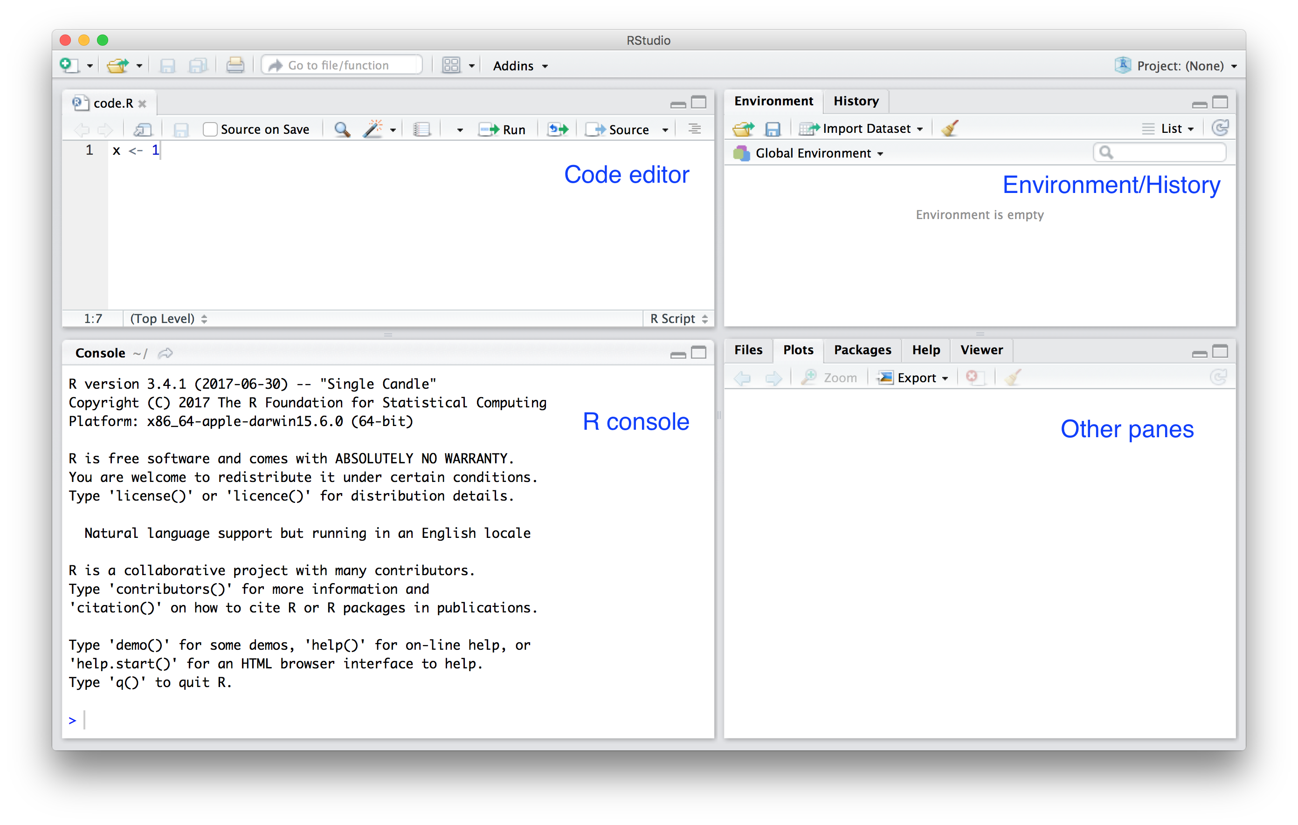
Let’s do some scripting
→ New File → Rscript →
Notes:
One of the great advantages of R over point-and-click analysis software is that you can save your work as scripts. You can edit and save these scripts using a text editor. The material in this book was developed using the interactive integrated development environment (IDE) RStudio. RStudio includes an editor with many R specific features, a console to execute your code, and other useful panes, including one to show figures.
You can see a pane where you write your scripts,
another one where you have the console, and other panes with other information,
as well as a place for your figures and plots to show up.

Slide 12
Let’s do some scripting
Results
→ New File → Rscript →
Notes:
One of the great advantages of R over point-and-click analysis software is that you can save your work as scripts. You can edit and save these scripts using a text editor. The material in this book was developed using the interactive integrated development environment (IDE) RStudio. RStudio includes an editor with many R specific features, a console to execute your code, and other useful panes, including one to show figures.
You can see a pane where you write your scripts,
another one where you have the console, and other panes with other information,
as well as a place for your figures and plots to show up.

Slide 13
The very basic: variables & functions
> a <- 1
> a
 [1] 1
> print a
 [1] 1

Slide 14
The very basic: variables & functions
> a <- 1
> a
 [1] 1
> print a
 [1] 1
> log(8)
 [1] 2.08
> help(“log”)
> ?log
> args(log)
function (x, base = exp(1))

Slide 15
The very basic: variables & functions
ax²+bx+c=0
> a <- 1
> b <- 1
> c <- -1
> (-b + sqrt(b^2 - 4*a*c) ) / ( 2*a )
 [1] 0.618
> (-b + sqrt(b^2 - 4*a*c) ) / ( 2*a )
 [1] -1.62
## Code to compute solution to quadratic equation of the form ax^2 + bx + c
## define the variables
a <- 3
b <- 2
c <- -1
## now compute the solution
Sol1 <- (-b + sqrt(b^2 - 4*a*c)) / (2*a)
Sol2 <- (-b - sqrt(b^2 - 4*a*c)) / (2*a)

Slide 16
Exercise
What is the sum of the first 100 positive integers? The formula for the sum of integers 1 through n is n(n+1)/2. Define n=100 and then use R to compute the sum of 1 through 100 using the formula. What is the sum?

Slide 17
Data types & data frame
> a <- 1
> class(a)
 [1] “numeric”
> print a
 [1] 1

Slide 18
Data types & data frame
> a <- 1
> class(a)
 [1] “numeric”
> print a
 [1] 1
> library(dslabs)
> data(murders)
> class(murders)
 [1] "data.frame"

Slide 19
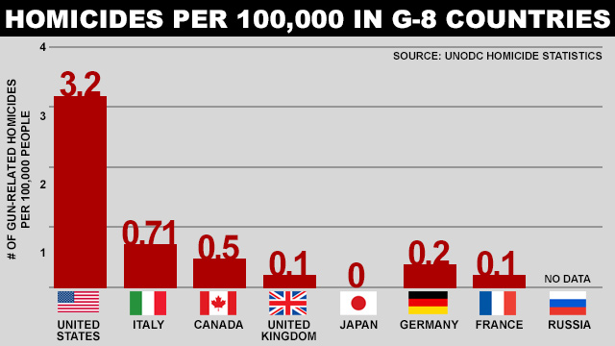
The data frame “murders”
(Source: Ma’ayan Rosenzweigh/ABC News, Data from UNODC Homicide Statistics)

Slide 20
Examining data frame
The function str is useful for finding out more about the structure of an object:
> str(murders)
We can show the first six lines using the function head:
> head(murders)
To reveal the names for each of the variables stored in this table we use the function names :
> names(murders)
To access the different variables represented by columns included in this data frame, we use the accessor operator $
> murders$population

Slide 21
Vectors
The object murders$population is not one number but several.
We call these types of objects vectors.
A single number is technically a vector of length 1, but in general we use the term vectors to refer to objects with several entries.
> class(murders$population)
 [1] " numeric "
> length(murders$population)
 [1] 51
> class(murders$states)
 [1] " character "
> class(murders$region)
 [1] " factor "
> levels(murders$region)
[1] "Northeast" "South" "North Central" "West"
> z <- 3 == 2
[1] FALSE
> class(z)
 [1] " logical "

Slide 22
Lists
> mylist = list(name='Charles',age=28,married=TRUE)
> mylist
## $name
## [1] "Charles"
## $age
## [1] 28
## $married
## [1] TRUE
> out = t.test(1:10, y = c(7:20))
> out
 ## Welch Two Sample t-test
## data: 1:10 and c(7:20)
## t = -5.4349, df = 21.982, p-value = 1.855e-05
## alternative hypothesis: true difference in means is not equal to 0
## 95 percent confidence interval:
## -11.052802 -4.947198
## sample estimates:
## mean of x mean of y
## 5.5 13.5
Lists are objects able to store information of different types. All functions return lists, so it is important to be able to manipulate them!

Slide 23
Matrices
> mat <- matrix(1:12, 4, 3)
#> [,1] [,2] [,3]
#> [1,] 1 5 9
#> [2,] 2 6 10
#> [3,] 3 7 11
#> [4,] 4 8 12
> mat[2, 3]
#> [1] 10
> mat[2, ]
#> [1] 2 6 10
> mat[, 3]
#> [1] 9 10 11 12
> mat[, 2:3]
#> [,1] [,2]
#> [1,] 5 9
#> [2,] 6 10
#> [3,] 7 11
#> [4,] 8 12
> as.data.frame(mat)
Matrices are similar to data frames in that they are two-dimensional: they have rows and columns.
However, like numeric, character and logical vectors, entries in matrices have to be all the same type.
Yet matrices have a major advantage over data frames: we can perform a matrix algebra operations, a powerful type of mathematical technique.

Slide 24
Exercise
Load the US murders dataset.
Use the accessor $ to extract the state abbreviations and assign them to the object a. What is the class of this object?
Now use the square brackets to extract the state abbreviations and assign them to the object b. Use the identical function to determine if a and b are the same.
The function table takes a vector and returns the frequency of each element. You can quickly see how many states are in each region by applying this function. Use this function in one line of code to create a table of states per region.

Slide 25
Vectors
In R, the most basic objects available to store data are vectors. As we have seen, complex datasets can usually be broken down into components that are vectors. For example, in a data frame, each column is a vector.

Slide 26
Create vectors
> codes <- c(380, 124, 818)
#> [1] 380 124 818
> country <- c("italy", "canada", "egypt")
> codes <- c(italy = 380, canada = 124, egypt = 818)
#> italy canada egypt
#> 380 124 818
> class(codes)
#> [1] "numeric"]
> names(codes)
#> [1] "italy" "canada" "egypt"
We can create vectors using the function c, which stands for concatenate.

Slide 27
Create vectors
> codes <- c(380, 124, 818)
#> [1] 380 124 818
> country <- c("italy", "canada", "egypt")
> codes <- c(italy = 380, canada = 124, egypt = 818)
#> italy canada egypt
#> 380 124 818
> class(codes)
#> [1] "numeric"]
> names(codes)
#> [1] "italy" "canada" "egypt"
> seq(1, 10)
#> [1] 1 2 3 4 5 6 7 8 9 10
Another useful function for creating vectors generates sequences:

Slide 28
Create vectors
> codes <- c(380, 124, 818)
#> [1] 380 124 818
> country <- c("italy", "canada", "egypt")
> codes <- c(italy = 380, canada = 124, egypt = 818)
#> italy canada egypt
#> 380 124 818
> class(codes)
#> [1] "numeric"]
> names(codes)
#> [1] "italy" "canada" "egypt"
> seq(1, 10)
#> [1] 1 2 3 4 5 6 7 8 9 10
> codes[2]
#> canada
#> 124
> codes[c(1,3)]
#> italy egypt
#> 380 818
> codes[1:2]
#> italy canada
#> 380 124
Subsetting a vector

Slide 29
Coercion
In general, coercion is an attempt by R to be flexible with data types. When an entry does not match the expected, some of the prebuilt R functions try to guess what was meant before throwing an error. This can also lead to confusion. Failing to understand coercion can drive programmers crazy when attempting to code in R since it behaves quite differently from most other languages in this regard.
> x <- c(1, "canada", 3)
You expected an error message!

Slide 30
Coercion
In general, coercion is an attempt by R to be flexible with data types. When an entry does not match the expected, some of the prebuilt R functions try to guess what was meant before throwing an error. This can also lead to confusion. Failing to understand coercion can drive programmers crazy when attempting to code in R since it behaves quite differently from most other languages in this regard.
> x <- c(1, "canada", 3)
> x
#> [1] "1" "canada" "3"
> class(x)
#> [1] "character "
R coerced the data into characters.

Slide 31
Coercion
In general, coercion is an attempt by R to be flexible with data types. When an entry does not match the expected, some of the prebuilt R functions try to guess what was meant before throwing an error. This can also lead to confusion. Failing to understand coercion can drive programmers crazy when attempting to code in R since it behaves quite differently from most other languages in this regard.
> x <- c(1, "canada", 3)
> x
#> [1] "1" "canada" "3"
> class(x)
#> [1] "character "
R coerced the data into characters.
> x <- 1:5
> y <- as.character(x)
> y
#> [1] "1" "2" "3" "4" "5"
> as.numeric(y)
#> [1] 1 2 3 4 5
R also offers functions to change from one type to another.

Slide 32
Exercise
Create two vectors of different dimensions and insert the second one in the first one between the 2nd and 3rd elements.
Draw 100 numbers from a Uniform distribution on [0,1] and count how many values are larger than 0.5
Compute the per 100,000 murder rate for each state and store it in the object murder_rate. Then compute the average murder rate for the US using the function mean. What is the average?

Slide 33
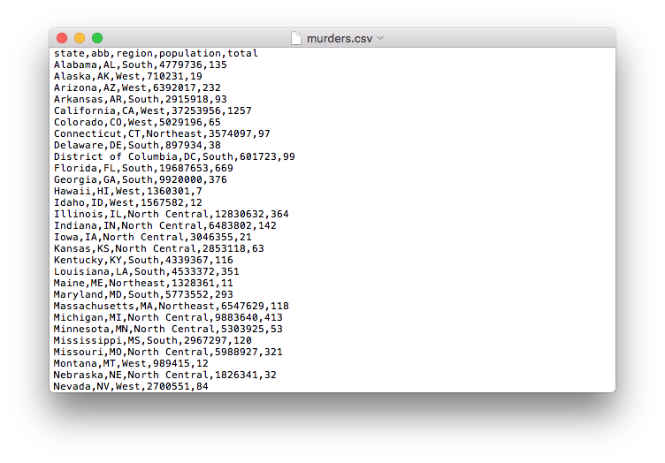
Importing data
When creating spreadsheets with text files, like the ones created with a simple text editor, a new row is defined with return and columns are separated with some predefined special character. The most common characters are comma (,), semicolon (;), space (`) and tab ( or`, a preset number of spaces).
Notes:
We have been using data sets already stored as R objects. A data scientist will rarely have such luck and will have to import data into R from either a file, a database, or other sources. Currently, one of the most common ways of storing and sharing data for analysis is through electronic spreadsheets. A spreadsheet stores data in rows and columns. It is basically a file version of a data frame. When saving such a table to a computer file, one needs a way to define when a new row or column ends and the other begins. This in turn defines the cells in which single values are stored. When creating spreadsheets with text files, like the ones created with a simple text editor, a new row is defined with return and columns are separated with some predefined special character. The most common characters are comma (,), semicolon (;), space (`) and tab ( or`, a preset number of spaces).

Slide 34
The filesystem
The working directory
> wd <- getwd()
The path of a file is a list of directory names that can be thought of as instructions on what folders to click on, and in what order, to find the file.
> system.file(package = "dslabs")
#> [1] "/Library/Frameworks/R.framework/Versions/3.5/Resources/library/dslabs »
> filename <- "murders.csv"
> dir <- system.file("extdata", package = "dslabs")
> fullpath <- file.path(dir, filename)
We can use the function list.files to see examples of relative path
> dir <- system.file(package = "dslabs") list.files(path = dir)
#> [1] "data" "DESCRIPTION" "extdata" "help" "html" #> [6] "INDEX" "Meta" "NAMESPACE" "R" "script"
Copying files using paths
> file.copy(fullpath, "murders.csv")
#> [1] TRUE
Notes:
You can think of your computer’s filesystem as a series of nested folders, each containing other folders and files. Data scientists refer to folders as directories. We refer to the folder that contains all other folders as the The root directory. We refer to the directory in which we are currently located as the working directory. The working directory therefore changes as you move through folders: think of it as your current location.

Slide 35
The readr and readxl packages
readr
readxl
Function | Format | Typical suffix
read_table | white space separated values | txt
read_csv | comma separated values | csv
read_csv2 | semicolon separated values | csv
read_tsv | tab delimited separated values | tsv
read_delim | general text file format, must define delimiter | txt
Function | Format | Typical suffix
read_excel | auto detect the format | xls, xlsx
read_xls | original format | xls
read_xlsx | new format | xlsx
> library(readr)
> read_lines("murders.csv", n_max = 3)
#> [1] "state,abb,region,population,total" "Alabama,AL,South,4779736,135"
#> [3] "Alaska,AK,West,710231,19 »
> dat <- read_csv(filename)
> head(dat)
R-base also provides import functions. These have similar names to those in the tidyverse, for example read.table, read.csv and read.delim

Slide 36
Exercises
Write a script allowing to load a vector file and “remove” the missing values.

Slide 37
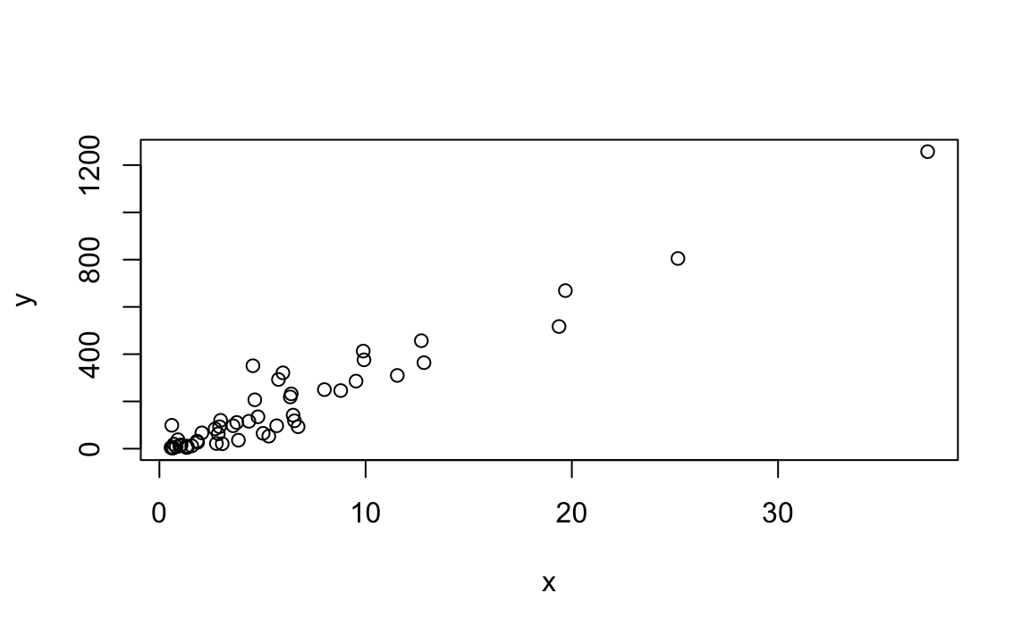
Basic plots
The plot function can be used to make scatterplots.
> x <- murders$population / 10^6
> y <- murders$total
> plot(x, y)

Slide 38
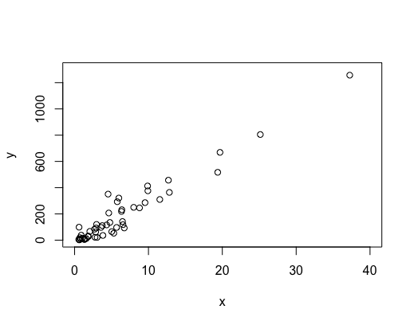
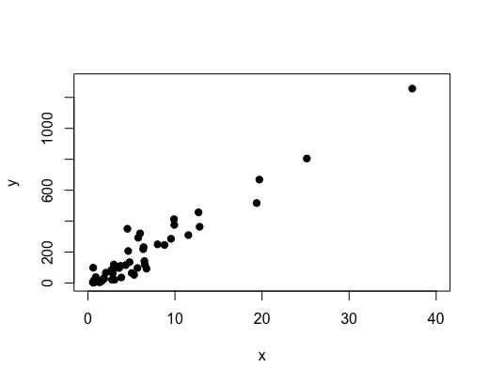
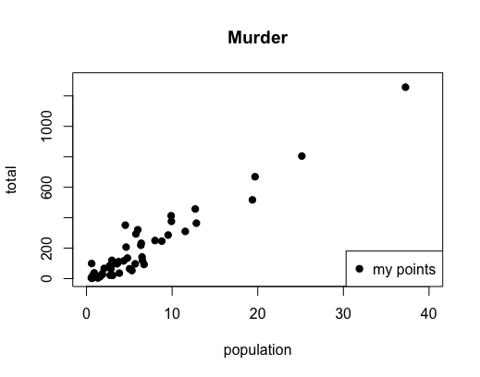
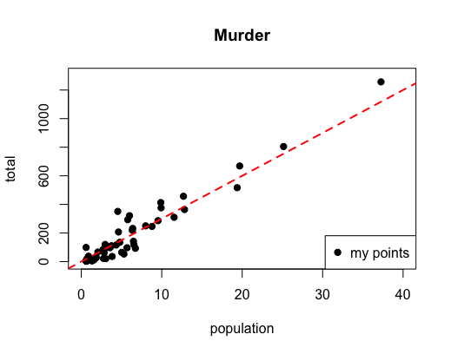
Basic plots
> plot(x, y, xlim=c(0, 40), ylim=c(0,1300))
> plot(x, y, xlim=c(0, 40), ylim=c(0,1300), pch=19)
> plot(x, y, xlim=c(0, 40), ylim=c(0,1300), pch=19, xlab="population", ylab="total", main="Murder")
> legend("bottomright", legend = 'my points',col=1,pch=19)
> plot(x, y, xlim=c(0, 40), ylim=c(0,1300), pch=19, xlab="population", ylab="total", main="Murder")
> legend("bottomright", legend = 'my points',col=1,pch=19)
> abline(a=0,b=30,lty=2, lwd=2,col='red')

Slide 39
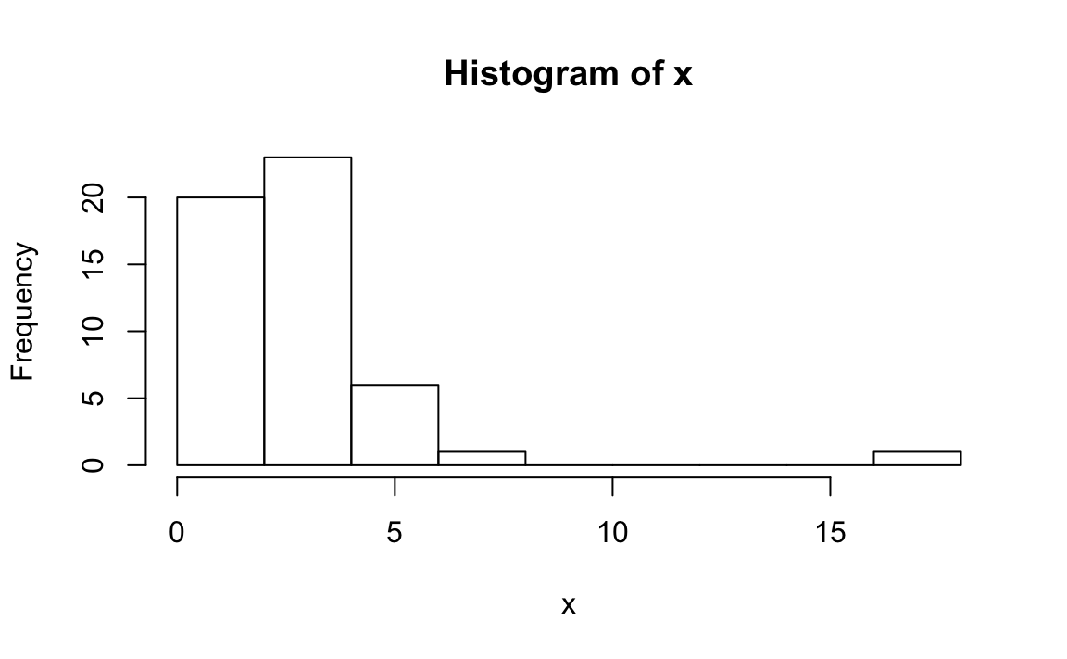
Basic Statistics: histograms
We can make a histogram of our murder rates by simply typing:
> x <- with(murders, total / population * 100000)
> hist(x)
> murders$state[which.max(x)]
#> [1] "District of Columbia"
Notes:
we will simply note that histograms are a powerful graphical summary of a list of numbers that gives you a general overview of the types of values you have.

Slide 40
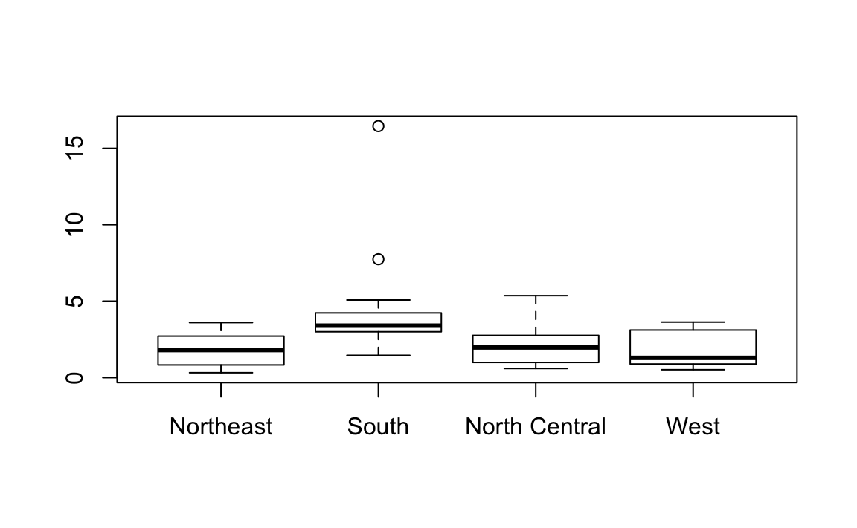
Basic Statistics: boxplots
We can use boxplots to compare the murder rates of different regions:
> murders$rate <- with(murders, total / population * 100000)
> boxplot(rate~region, data = murders)
Notes:
They provide a more terse summary than histograms, but they are easier to stack with other boxplots.

Slide 41
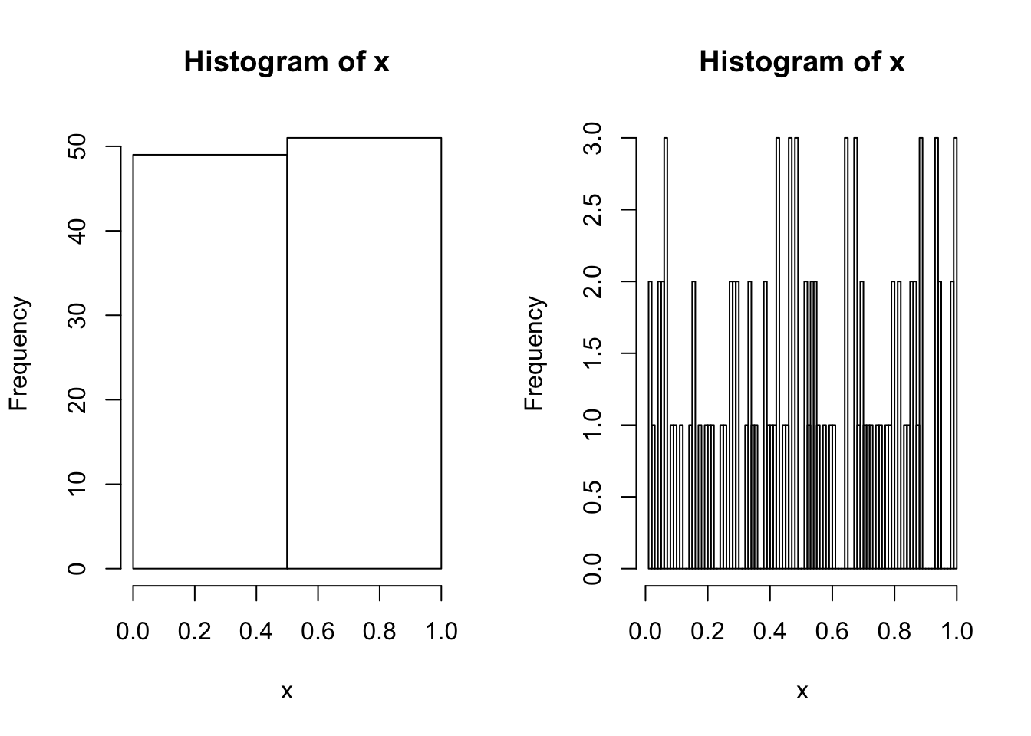
Histograms
x = runif(100,0,1)
par(mfrow=c(1,2))
hist(x,breaks=2)
hist(x,breaks=100)

Slide 42
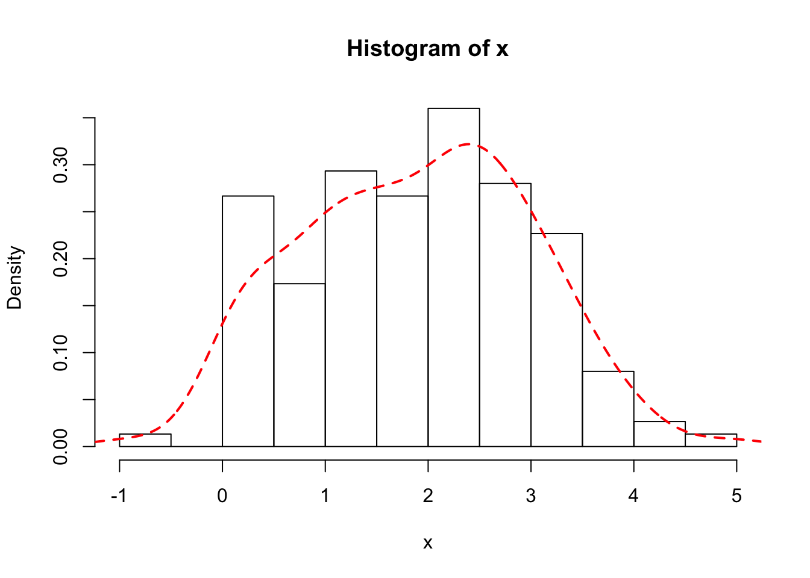
Density plot
x = c(rnorm(100,2,1),rgamma(50,shape = 1))
hist(x,freq = FALSE)
f = density(x)
lines(f,lwd=2,col='red',lty=2)

Slide 43
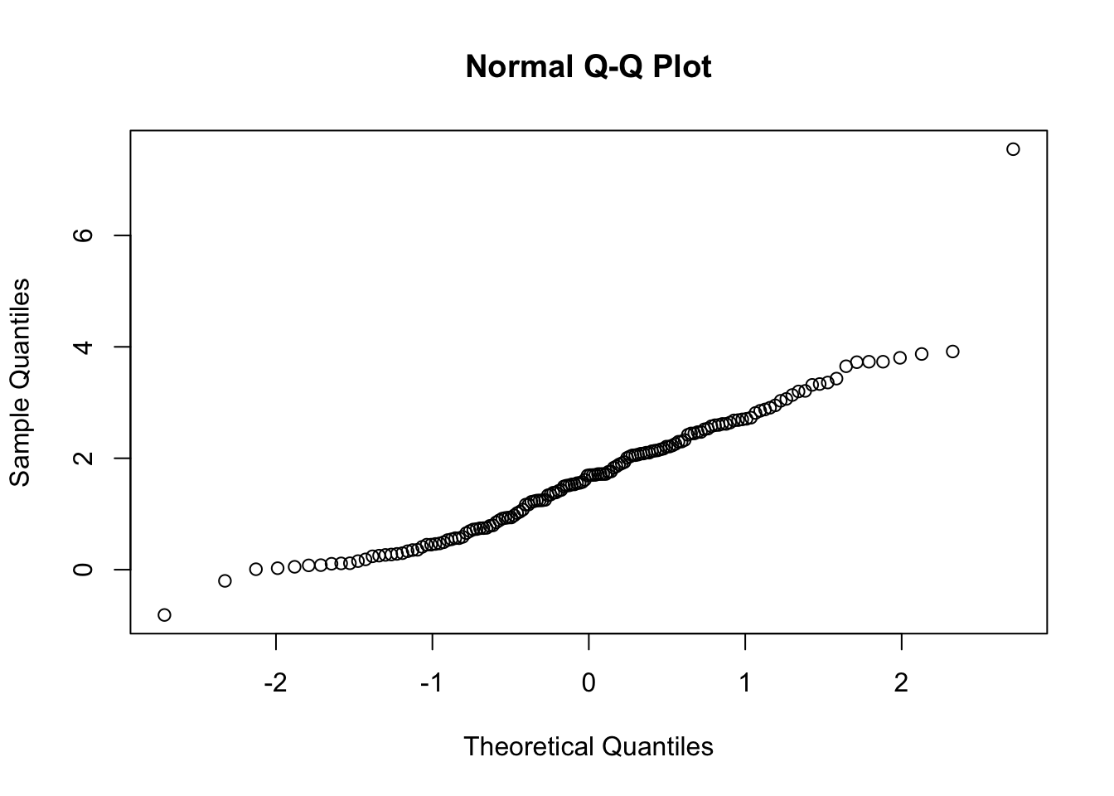
Compare distributions
x = c(rnorm(100,2,1),rgamma(50,shape = 1))
qqnorm(x)

Slide 44
Basic Statistics: piecharts
Finally, for categorical variables, you can draw pie plots:
> pie(summary(murders$region))

Slide 45
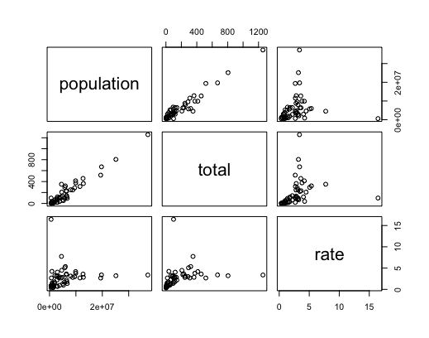
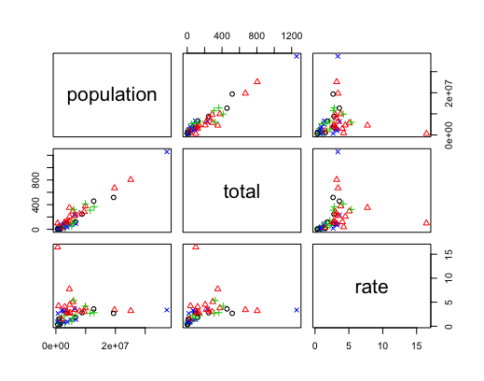
Basic Statistics: pairplot
> x<-murders[,4:6]
> pairs(x)
> x<-murders[,4:6]
> pairs(x, col=as.numeric(murders$region), pch=as.numeric(murders$region))

Slide 46
Exercises
Create a histogram of the state populations.
Generate boxplots of the state populations by region.

Slide 47
Functions
Writing functions is a core activity of an R programmer. It represents the key step of the transition from a mere “user” to a developer who creates new functionality for R. Functions are often used to encapsulate a sequence of expressions that need to be executed numerous times, perhaps under slightly different conditions. Functions are also often written when code must be shared with others or the public.
The writing of a function allows a developer to create an interface to the code, that is explicitly specified with a set of parameters. This interface provides an abstraction of the code to potential users. This abstraction simplifies the users’ lives because it relieves them from having to know every detail of how the code operates. In addition, the creation of an interface allows the developer to communicate to the user the aspects of the code that are important or are most relevant.

Slide 48
Functions in R
Functions in R are “first class objects”, which means that they can be treated much like any other R object.
Importantly,
Functions can be passed as arguments to other functions. This is very handy for the various apply functions, like lapply() and sapply().
Functions can be nested, so that you can define a function inside of another function
If you’re familiar with common language like C, these features might appear a bit strange. However, they are really important in R and can be useful for data analysis.

Slide 49
Your First Function
Functions are defined using the function() directive and are stored as R objects just like anything else. In particular, they are R objects of class “function”.
Here’s a simple function that takes no arguments and does nothing.
Here we create a function that actually has a non-trivial function body.
> f <- function() {
+ ## This is an empty function
+ }
> ## Functions have their own class
> class(f)
[1] "function"
> ## Execute this function
> f()
NULL
> f <- function() {
+ cat("Hello, world!\n")
+ }
> f()
Hello, world!

Slide 50
Your First Function
The last aspect of a basic function is the function arguments. These are the options that you can specify to the user that the user may explicity set.
This next function returns the total number of characters printed to the console.
For this basic function, we can add an argument that determines how many times “Hello, world!” is printed to the console.
> f <- function(num) {
+ hello <- "Hello, world!\n"
+ for(i in seq_len(num)) {
+ cat(hello)
+ }
+ chars <- nchar(hello) * num
+ chars
+ }
> meaningoflife <- f(3)
Hello, world!
Hello, world!
Hello, world!
> print(meaningoflife)
[1] 42
> f <- function(num) {
+ for(i in seq_len(num)) {
+ cat("Hello, world!\n")
+ }
+ }
> f(3)
Hello, world!
Hello, world!
Hello, world!

Slide 51
Your First Function
Here, for example, we could set the default value for num to be 1, so that if the function is called without the num argument being explicitly specified, then it will print “Hello, world!” to the console once.
> f <- function(num = 1) {
+ hello <- "Hello, world!\n"
+ for(i in seq_len(num)) {
+ cat(hello)
+ }
+ chars <- nchar(hello) * num
+ chars
+ }
> f() ## Use default value for 'num'
Hello, world!
[1] 14
> f(2) ## Use user-specified value
Hello, world!
Hello, world!
[1] 28
At this point, we have written a function that
has one formal argument named num with a default value of 1. The formal arguments are the arguments included in the function definition. The formals() function returns a list of all the formal arguments of a function
prints the message “Hello, world!” to the console a number of times indicated by the argument num
returns the number of characters printed to the console

Slide 52
Argument Matching
Calling an R function with arguments can be done in a variety of ways. This may be confusing at first, but it’s really handing when doing interactive work at the command line. R functions arguments can be matched positionally or by name. Positional matching just means that R assigns the first value to the first argument, the second value to second argument, etc. So in the following call to rnorm()
> str(rnorm)
function (n, mean = 0, sd = 1)
> mydata <- rnorm(100, 2, 1) ## Generate some data
100 is assigned to the n argument, 2 is assigned to the mean argument, and 1 is assigned to the sd argument, all by positional matching.

Slide 53
Argument Matching
The following calls to the sd() function (which computes the empirical standard deviation of a vector of numbers) are all equivalent. Note that sd() has two arguments: x indicates the vector of numbers and na.rm is a logical indicating whether missing values should be removed or not.
> ## Positional match first argument, default for 'na.rm'
> sd(mydata)
[1] 1.014325
> ## Specify 'x' argument by name, default for 'na.rm'
> sd(x = mydata)
[1] 1.014325
> ## Specify both arguments by name
> sd(x = mydata, na.rm = FALSE)
[1] 1.014325

Slide 54
Lazy Evaluation
Arguments to functions are evaluated lazily, so they are evaluated only as needed in the body of the function.
In this example, the function f() has two arguments: a and b.
> f <- function(a, b) {
+ a^2
+ }
> f(2)
[1] 4
This function never actually uses the argument b, so calling f(2) will not produce an error because the 2 gets positionally matched to a. This behavior can be good or bad. It’s common to write a function that doesn’t use an argument and not notice it simply because R never throws an error.

Slide 55
Lazy Evaluation
This example also shows lazy evaluation at work, but does eventually result in an error.
> f <- function(a, b) {
+ print(a)
+ print(b)
+ }
> f(45)
[1] 45
Error in print(b): argument "b" is missing, with no default
Notice that “45” got printed first before the error was triggered. This is because b did not have to be evaluated until after print(a). Once the function tried to evaluate print(b) the function had to throw an error.

Slide 56
The ... Argument
There is a special argument in R known as the ... argument, which indicate a variable number of arguments that are usually passed on to other functions. The ... argument is often used when extending another function and you don’t want to copy the entire argument list of the original function
For example, a custom plotting function may want to make use of the default plot() function along with its entire argument list. The function below changes the default for the type argument to the value type = "l" (the original default was type = "p").
myplot <- function(x, y, type = "l", ...) {
plot(x, y, type = type, ...) ## Pass '...' to 'plot' function
}
Generic functions use ... so that extra arguments can be passed to methods.
> mean
function (x, ...)
UseMethod("mean")
<bytecode: 0x7fe2e9aead40>
<environment: namespace:base>

Slide 57
Exercise
Data normalization
Create a function that normalizes a vector:
x_new = (x-mean(x))/std(x)
Use this function on the iris dataset so that each column is normalized
You can also make the function more general
x_new = (x-a)/b
and use it to preprocess the data with min/(max-min) instead of mean/std
Trainig/test sets
Create a new file with a function that split a dataframe into train-valid-test set, given 3 ratios

Slide 58
Summary
Functions can be defined using the function() directive and are assigned to R objects just like any other R object
Functions have can be defined with named arguments; these function arguments can have default values
Functions arguments can be specified by name or by position in the argument list
Functions always return the last expression evaluated in the function body
A variable number of arguments can be specified using the special ... argument in a function definition.

